Slide 1
Advocacy Insider
PRESENTER: Erin Arnold, MD, FACR Board Member, CSRO

Slide 2
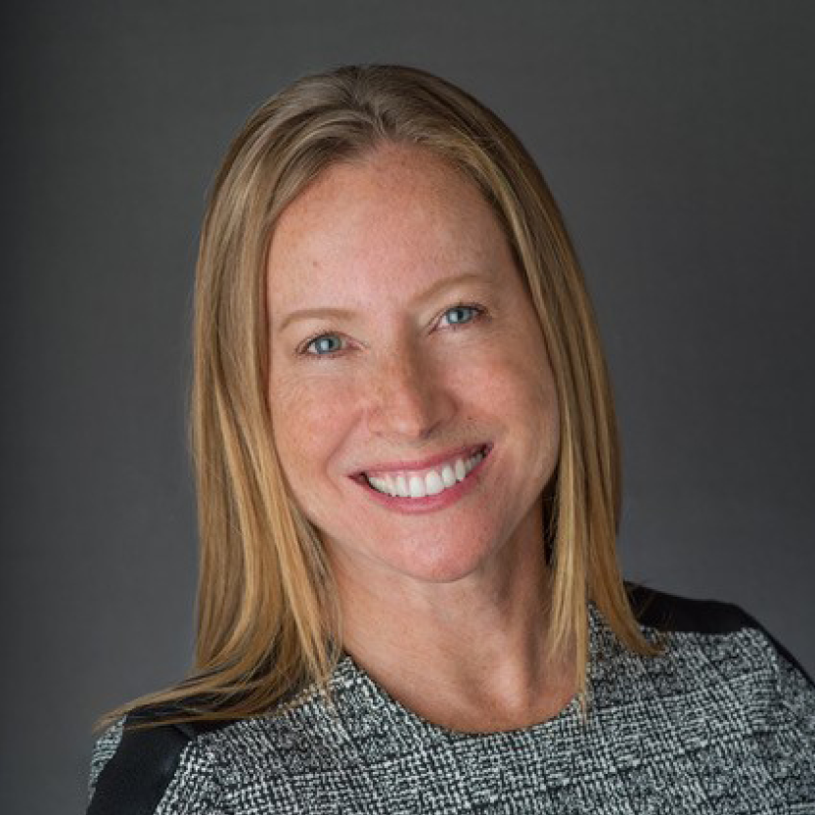
Coalition of State Rheumatology Organizations
Erin Arnold, MD, FACR
Board Member, CSRO
Advocacy Co-Chair, Chicago Rheumatism Society

Slide 3
340B: Impact on Rheumatology
Drives healthcare consolidation, threatening viability of private rheumatology practices
340B hospitals and their off-campus facilities receive a 20-50% discount on provider administered medications
Large 340B hospitals responsible for approximately 80% of hospital acquisitions (2016-2022)
Price markups at
340B eligible hospitals
were over
6x
HIGHER in
independent physician practices.

Slide 4
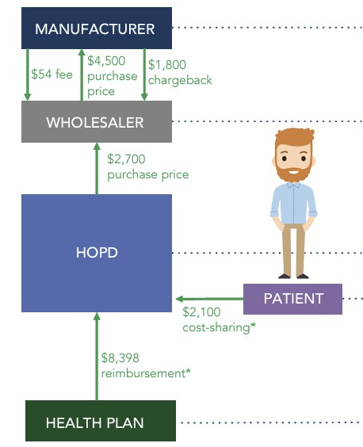
Follow the Dollar: 340B Hospital Buy-and-Bill Model
Manufacturer Keeps: $2,646
Wholesaler Keeps: $54
34%
mark up
340B Hospital Keeps: $7,798
Patient Cost Sharing: $2,100
Health Plan Pays 340B Hospital: $8,398

Slide 5

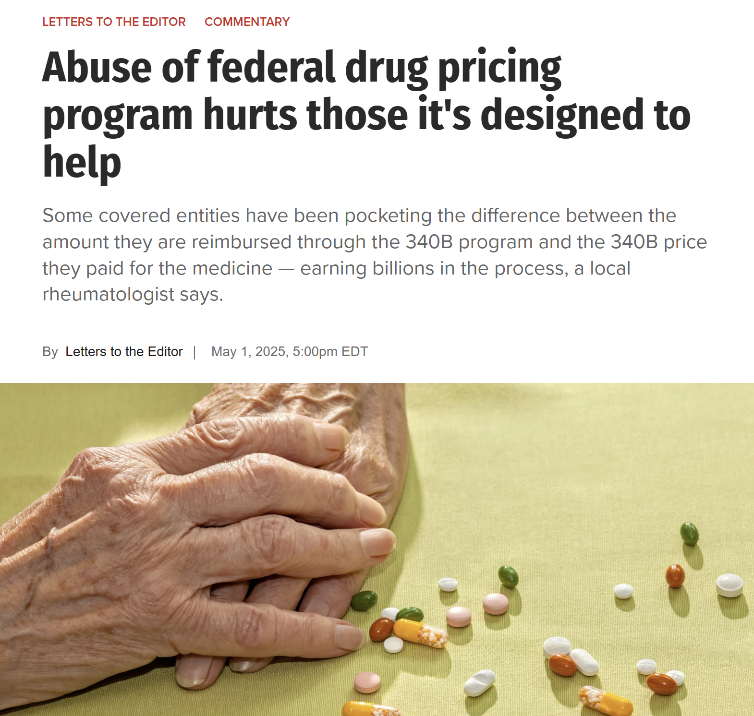
Notes:
https://chicago.suntimes.com/letters-to-the-editor/2025/05/01/federal-drug-pricing-program-340b-abuse-donald-trump-fdr-100-days-kristi-noem-stolen-purse

Slide 6
340B: CSRO Policy Principles
1 | Support safety-net providers participating in the 340B program who provide care to low-income and uninsured patients in underserved communities
2 | Clarify the definition of “patient” to ensure that underserved, low-income and uninsured patients receive discounted medications, as the program intended
3 | Require low-income and uninsured eligible patients receive 340B drug discounts intended for them through their providing 340B covered entity and associated contract pharmacy
4 | Improve oversight, transparency, accountability and reporting for 340B covered entities to promote trust and accountability within the 340B program
5 | Implement standards for 340B child sites that minimize large healthcare system consolidation that threatens independent rheumatology practices

